Slide 1
More Power with Your Payroll
Lisa Thomas
Business Leader
Equifax Workforce Solutions UK

Slide 2
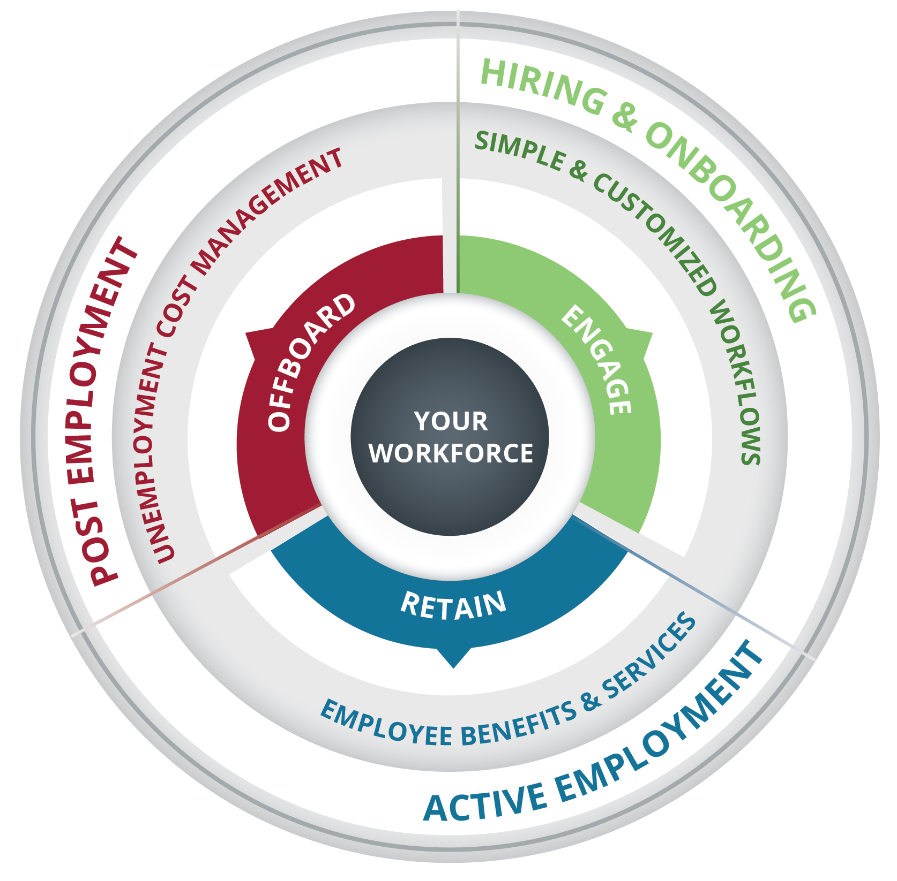
Your success and your workforce is at the center of everything we do.
We are as driven as you to help support your employees and their experiences, while helping reduce your HR burden across the employment lifecycle.
PROPRIETARY | ‹#›

Slide 3
The Verification Exchange
Reduce HR workload and provide an important employee benefit with instant income and employment verifications.

Slide 4
Employees rely upon employers to provide verifications to help support life events.
Income and employment verifications can take valuable time away from strategic work. They can also put your organization and employee data privacy at greater risk.
Auto Loan
Mortgage
What if you could support your employees with quicker verifications, 24/7?
Teleco or Utility Setup
Apartment Rental
New Credit Card
New Job
INSIGHT 80% of employers report that financial stress is impacting their employees' job performance, including increased stress, difficulty focusing, and missing work/tardiness.
Benefits Qualification
New Insurance Policy
Line of Credit
Source: https://shrm.org/ResourcesAndTools/hr-topics/benefits/Pages/Employees-Financial-Issues-Affect-Their-Job-Performance.aspx

Slide 5
Putting The Verification Exchange to Work
R
THE WORK NUMBER®
Helps millions of people demonstrate eligibility for services .Helps maintain greater employee privacy
May improve borrower experience by reducing rate-lock period and speeding up closing
Mortgages
Government Aid
Auto Loans
Auto applicants ¹
24/7 verification allows a salesperson to verify a customer’s employment or income instantly, even after hours, with no pay stubs needed
Credit Cards
When instantly verified by The Verification Exchange. Can assist in helping people with non-prime (low score or thin credit file) by verifying income
Notes:
Admin Notes: DO NOT REMOVE
Master Presentation Slide
Here are some real life examples of how automated verifications from The Work Number help to support employees, like yours, 24/7
When applying for a mortgage:
May reduce rate-lock period and speed up closing for better borrower experience
Auto loans:
When verified by The Work NumberⓇ, auto applicants are 46% more likely to be funded¹
24/7 verification allows a salesperson to verify a customer instantly, even after hours, no pay stubs needed
Government Aid:
Helps millions of applicants demonstrate eligibility for social services programs such as SNAP, TANF, Medicaid, CSE and more
Helps maintain employee privacy
Credit Cards:
When instantly verified by The Work Number, applicants are 34% more likely to be funded. Can assist in helping to approve non-prime (low score or thin credit file) borrowers by verifying income

Slide 6
Reduce Your Workload and Provide an Important Employee Benefit
Automate your employment and income verifications with The Verification Exchange
Helping your employees get faster decisions for credit and benefits through automation is just one way you can help empower them to live their financial best
Help simplify your HR workload and help mitigate risk
Verifiers are vetted and must meet strict security standards to access data
Help employees more easily secure life’s important moments, 24/7

Slide 7
THE WORK NUMBER®
Employee Profile
Name: Sarah
Age: 43
Occupation: Mid-level manager at a small firm
Goal: Obtain quick mortgage approval in a competitive housing market, and at a low rate
Information is NOT included on The Verification Exchange
Information IS included on The Verification Exchange
A delay in the verification process causes Sarah to miss her rate lock period and rates are now higher
Sarah’s income and employment are instantly verified and she’s able to lock in at the rate she wants
Another delay during the final check before closing causes Sarah to lose the house
Sarah’s closing process goes smoothly and she closes on her dream home
Characters depicted are fictional and for demonstration purposes only. Individual results may vary.

Slide 8
Verification Exchange Employer Features
24/7 automated transfer of information between your employer and verifiers, at no cost to you
Governed by the Financial Conduct Authority (FCA) and only accessed by credentialed verifiers with auditable, permissible purpose
The FCA requires permissible purpose from verifier organizations in order to obtain income and employment data.
Under the FCA, employees have transparency into what information is shared and are able to dispute their data at any time.
FCA regulations and security help protect employee data.

Slide 9
Macro trends driving demand for instant verifications
EFFECT | REACTION | IMPACT
Mortgage activity remains tight and variable |  | Fewer people are purchasing or refinancing homes. |  | Instant verifications reduce time to offer and certainty of interest rate
Interest Rates¹
Certain verticals (auto, credit card) have seen increased inquiries . |  | Vehicle purchases are higher during the Spring. Credit lines are often higher in the holiday season. |  | Fluctuations in verifications, especially verification of income, require more income information faster
CAUSE
Seasonality²
Rise in vulnerable consumers |  | Demand for services and aid request is projected to climb. |  | Organisations can adopt policies to automate eligibility systems to more easily and accurately process requests .
Aid/Service Request

Slide 10
Safeguarding Your Employees’ Data
THE WORK NUMBER®
The Verification Exchange is governed by the (FCA) and all verifiers must be credentialed and have permissible purpose
Verifiers and all their transactions are subject to planned and random audits to help ensure proper usage of the data received
Individual users are authenticated at log-in to help provide clear line-of-sight as to who is requesting the verification
The Verification Exchange service maintains globally recognized certifications in data management and security¹
Source: ¹Equifax, 2022

Slide 11
Consumers expect speed in all facets of their lives - including when it comes to applying for credit and or much needed services
Automated income and employment verifications for the digital world we live in:
No more searching for paystubs
Increased financial inclusion
A more frictionless, consumer-like experience
DID YOU KNOW?
Nearly 25% of verifications occur during weekends or after hours. The Verification Exchange is available 24/7, helping employees better secure life’s important moments more quickly.¹
¹2023 Equifax data study

Slide 13
How It Works
THE WORK NUMBER®
Faster decisions through automation helps drive life’s important moments for your employees.
Initiates a transaction that requires verification of employment and/or income
Requests income and employment information with permissible purpose*
Provides data real time directly to Verifier
Employees/
Consumers
Credentialed Verifiers
Employer Through Payroll Provider
Verification Exchange
Provides verification
Is wanting to buy a house, qualify for government benefits, needs a credit line increase, ect.
Data encrypted at rest and in transit
Mortgage, Auto, Credit, Background Screeners, Government, and more

